Slide 1

Ortho eyes
Tim Bekema
Beau Fiechter
Donna van Grunsven
Jasmijn Heupers
Emma Korf
Danny Vink

Slide 2
Table of contents
Ortho Eyes
Data
Feature selection
OR-ensemble
Training the model
Selecting the optimal hyperparameter value
Results
Conclusion

Slide 3
Ortho Eyes
Try to identify patients with rotator cuff injuries
Expanding and improving the previous iterations of the project
Two different cases:
Classifying patients from non-patients
Classifying patients with rotator cuff injuries from patients with regular shoulder pain

Slide 4
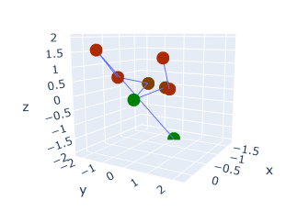
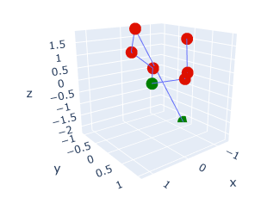
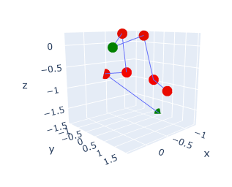
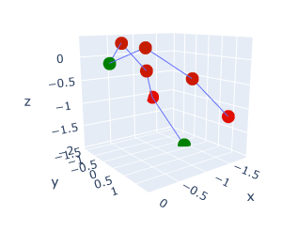
The Data
134 Individuals in 4 categories
Non-patients
Patients with shoulder pain
2 grades of rotator cuff injuries
4 Different exercises for each patient
Abduction (AB)
Anteflexion (AF)
Retroflexion (RF)
Endo- and exo-rotation low (EL)
Sensors on shoulders, elbows, wrists and sternum
XYZ coordinates in .txt files
AB
AF
EL
RF

Slide 5
Cleaning the data
Preventing to measure protocol
Manually cutting the data to contain only the exercise itself
Transforming the data
Fixing the sternum sensor at XYZ (0,0,0)
Scaling the data
Category sets contained different coordinate ranges
Setting the mean length of the upper arm to 1

Slide 6
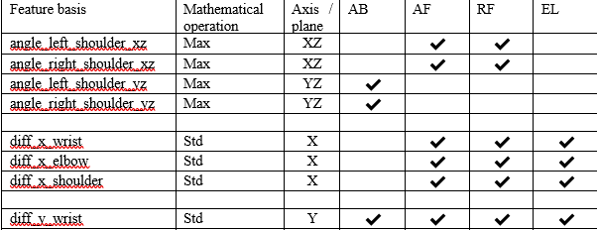
Feature selection
Try to replicate a physician’s diagnosis protocol
Shoulder angles and compensation behaviour
Velocity and acceleration of movements
Symmetry of movements
Deviation in an exercise
Examples of selected features and mathematical operations for specific exercise types
Notes:
Shoulder angle approaches 180 deg
Patients who cannot do this tend to raise their shoulder, increased chance
Non-patients tend to make smooth movements
Patients tend to have inconsistent velocities
Asymmetric movement for patients
Move around pain points

Slide 7
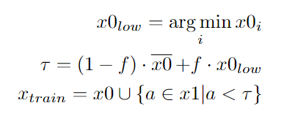
Discarding outliers
Comparing mean values of datapoints
Multiplying the high/low mean by hyperparameter f (Factor)
Equation for determining the trainingset for a feature
Visualization the effect of changing the hyperparameter value

Slide 8
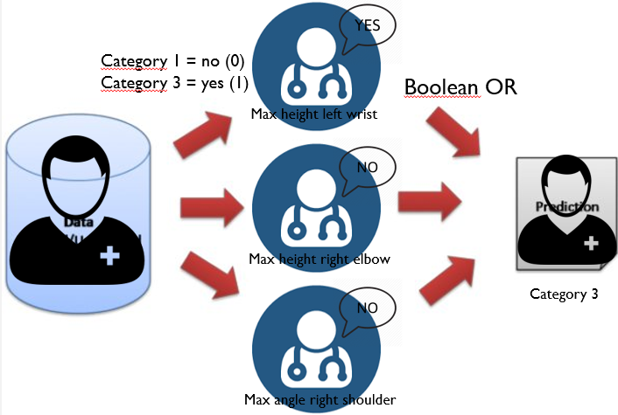
OR-ensemble
Ensemble method for one-sided regression models
Interpret the results (1 or 0) as Boolean values
Combining the results of each separate feature
Perform a Boolean OR-operation to get to final result
Simplified visualization of the OR-ensemble

Slide 9
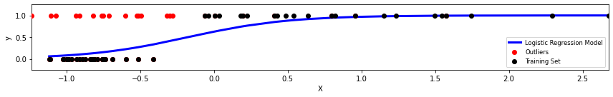
Training the model
80% of the total dataset
Leave-One-Out cross-validation
Discarding outliers
Automatically select features that evaluate a precision of 1.0
Output a set of features and confusion matrix
Example of a trained logistic regression model of a single feature

Slide 10
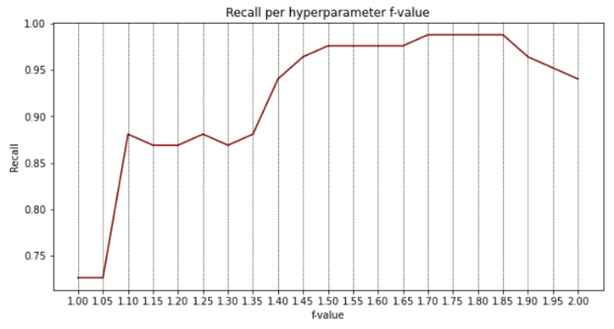
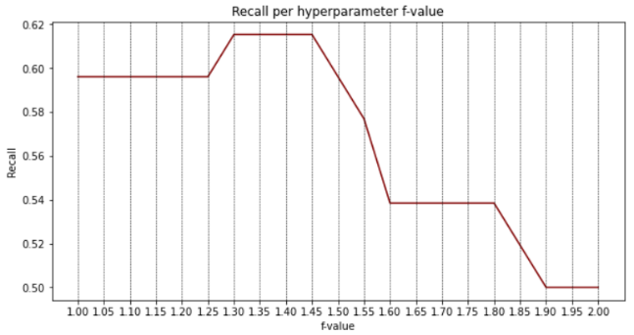
Selecting the optimal hyperparameter value
Training models for different factor values
Selecting a safe optimal value by checking the recall value
Case 1: Classifying patients from non-patients
Case 2: Classifying rotator cuff injuries

Slide 11
Results
Test dataset
20% of total dataset
 | Recall | Precision | Accuracy
Case 1 (f=1.7) | 0.98 | 1.0 | 0.99
Case 2 (f=1.45) | 0.61 | 1.0 | 0.76
 | Recall | Precision | Accuracy
Case 1 (f=1.7) | 0.95 | 0.9 | 0.88
Case 2 (f=1.45) | 0.58 | 0.78 | 0.63
Evaluation on training set
Evaluation of test set

Slide 12
Comparison to other ensemble methods
 | OR-ensemble f=1.7 | AdaBoost | Random Forest | Bagging | SVC
Precision | 0.9 | 0.74 | 0.96 | 0.8 | 0.87
Recall | 0.95 | 0.76 | 0.96 | 0.88 | 0.88
Accuracy | 0.88 | 0.76 | 0.96 | 0.88 | 0.88
 | OR-ensemble f=1.45 | AdaBoost | Random Forest | Bagging | SVC
Precision | 0.78 | 0.40 | 0.47 | 0.73 | 0.73
Recall | 0.58 | 0.63 | 0.52 | 0.75 | 0.73
Accuracy | 0.63 | 0.63 | 0.49 | 0.75 | 0.73
Case 1: Classifying patients from non-patients
Case 2: Classifying rotator cuff injuries

Slide 13
Conclusion
Identifying patients can be done quite well (95% of the cases)
Leaves 10% false positives
OR-ensemble does not outperform Random Forest
Identifying rotator cuff injuries not so well (58% of the cases)
Leaves 32% false positives
OR-ensemble does not outperform State-of-the-art Ensemble methods

Slide 14
Future research
Gather more data
Further improve outlier separation

Slide 15

Questions or feedback?

